Slide 1
British Airways – Customer Booking Prediction Model

Slide 2
agenda
Objective
Data Preparation
Model Development
Model Performance
Key Drivers of Booking Completion
Business Insights & Recommendations

Slide 3

Objective
To predict customer booking behaviour and understand what factors make customers more likely to complete a booking.

Slide 4
Data Preparation
Reviewed the customer booking dataset.
Checked for missing values and data quality issues.
Converted categorical variables (e.g., sales channel, trip type, route, booking origin) into numerical values using Label Encoding.
Converted flight day from text format (Mon, Tue, Wed, etc.) into numerical values.
Separated the data into:
Features (X): customer and booking information.
Target (y): booking completion (0 = No Booking, 1 = Booking Completed).
Split the dataset into training data (80%) and testing data (20%) for model development.

Slide 5
Model Development
Selected Random Forest Classifier as the machine learning algorithm.
Trained the model using 80% of the dataset.
Used the remaining 20% of the data for testing.
Generated predictions on customer booking completion.
Evaluated model performance using accuracy, classification metrics, and cross-validation.
Analyzed feature importance to identify the key factors influencing booking behaviour.

Slide 6

Model Performance
Random Forest model achieved an accuracy of 85.41%.
Average cross-validation score: 48.56%.
The model performed well on the test dataset but showed lower consistency across different data samples.
This suggests the model can predict bookings reasonably well, but further tuning could improve reliability.
Key Metrics
Metric | Result
Accuracy | 85.41%
Cross-Validation Score | 48.56%

Slide 7

Key Drivers of Booking Completion
Purchase Lead was the most important factor. This means customers who book their flights well in advance are more likely to complete their booking.
Route was the second most important factor. Some flight routes are more popular and have higher booking completion rates than others.
Flight Hour also played an important role. The time of departure can influence a customer's decision to book.
Length of Stay was another key factor. The number of days a customer plans to stay at their destination affects booking behaviour.
Booking Origin was important as well. Customers from different countries may have different booking patterns and preferences.

Slide 8
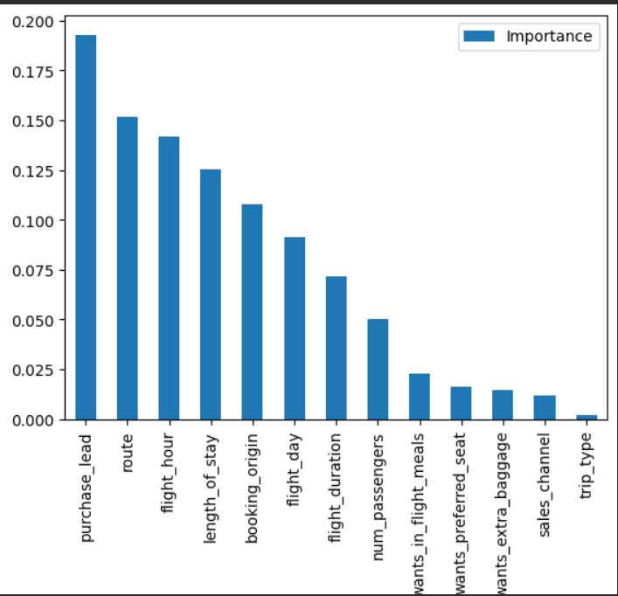
Chart

Slide 9
Business Insights
Customers who book flights earlier are more likely to complete their booking.
Flight route and departure time play an important role in customer decisions.
Customer travel patterns, such as length of stay and booking origin, help predict booking behaviour.
Additional services (baggage, meals, and preferred seats) have less influence on booking completion.

Slide 10
Recommendations
Target customers who book well in advance with personalized offers and promotions.
Focus marketing campaigns on key routes and peak booking periods.
Use customer booking patterns to improve targeting and increase conversion rates.
Continue improving the model by adding more customer and booking data to increase prediction accuracy.

Slide 11
Thank you

